Slide 1

Deciphering Insurance Complaints: A Data-Driven Approach

Slide 2

Project Overview
Goal of the project:
The primary goal of this project is to develop a predictive model that can determine whether an insurance complaint will be confirmed or not, based on historical data of complaints filed against various insurance companies.

Slide 3



Dataset Description
Source of data: data.gov
Key attributes: Complaint number, Type of insurance coverage, Company the complaint was filed against, Who filed the complaint, whether the complaint was confirmed or not, how it was resolved, and the dates when the complaint was received and closed.
Volume of records: 247392 records and 17 columns

Slide 4



Data Cleaning and Preprocessing
Handling datetime values : The 'Received date' and 'Closed date' columns were converted into a date-time format
Removing unnecessary columns: Columns that do not contribute to predicting a confirmed complaint, such as 'Complaint number' and 'Keywords,' were removed to streamline the dataset.
Encoding categorical variables: Non-numeric columns were transformed into a numerical format using Label Encoding

Slide 5
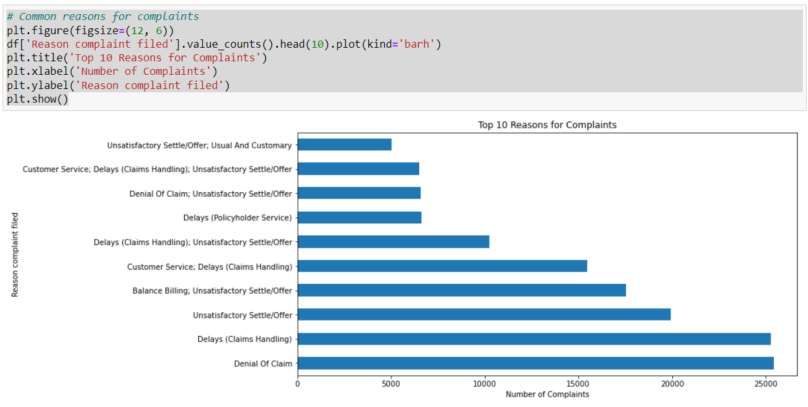
Exploratory Data Analysis
From the graph, we can clearly see that the most frequent reason for complaints is “Denial of Claims, Delays Claim Handling" indicating dissatisfaction particularly concerning typical or customary charges.

Slide 6
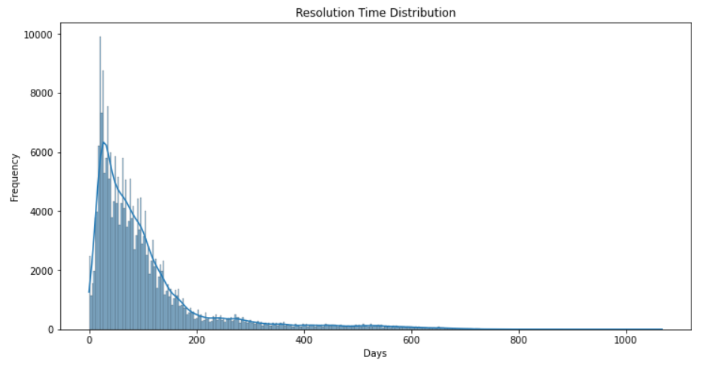
Exploratory Data Analysis
There is a very high peak at the left side of the graph, suggesting that many complaints were resolved within a short time span, potentially within the first few days or weeks. While most complaints were resolved promptly, there were some instances where complaint resolution took significantly longer, extending beyond several hundred days.

Slide 7
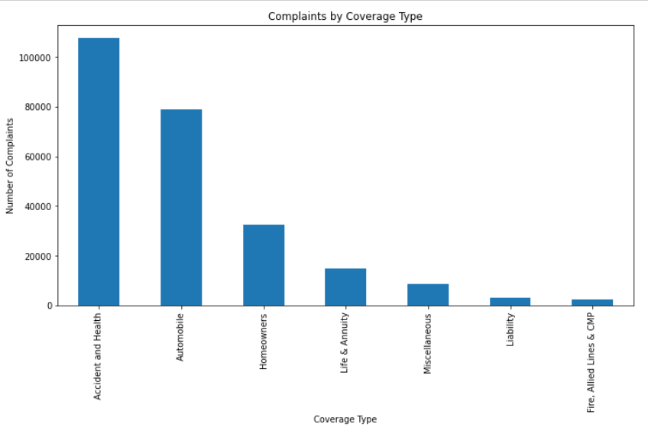
Exploratory Data Analysis
From the chart, it is evident that the highest number of complaints are related to "Accident and Health" coverage, followed by "Automobile" coverage. These two coverage types account for most complaints in the dataset.

Slide 8

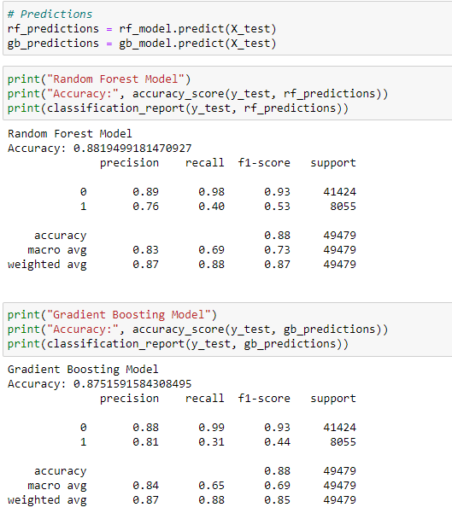
Predictive Model Building
I chose two robust predictive models for this project – the Random Forest and Gradient Boosting classifiers. Both are powerful methods capable of handling the complexity of the dataset and providing insights into which features most affect complaint confirmation.

Slide 9
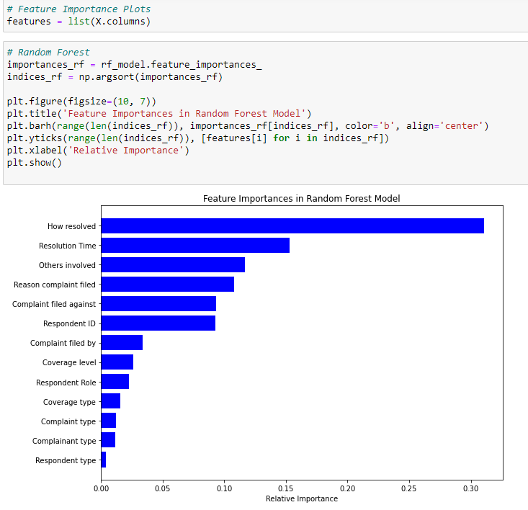
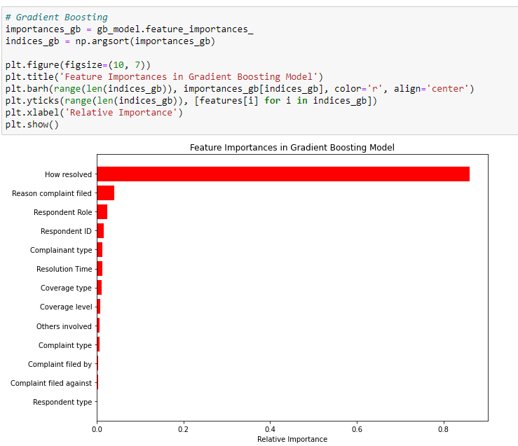
Model Evaluation and Comparison
i
We can clearly see that 'How resolved' and 'Reason complaint filed' are very influential for both models, suggesting that the resolution method and the reason for filing a complaint are strong indicators of whether a complaint will be confirmed.

Slide 10
Key Findings and Insights
The analysis led to some interesting findings. For instance, the reason a complaint was filed and how it was resolved were significant predictors of confirmation.
These insights have meaningful implications for how insurance companies can prioritize their response to complaints.

Slide 11
Conclusion
This project not only highlighted the prevalent issues in insurance complaints but also offered a predictive viewpoint that companies can use to streamline their customer service processes. Focusing on the areas that lead to confirmed complaints will significantly improve customer satisfaction.

Slide 12
References
1. Insurance Complaints Dataset. Retrieved from [https://catalog.data.gov/dataset/insurance-complaints-all-data]
2. McKinney, W. (2018). Python for Data Analysis: Data Wrangling with Pandas, NumPy, and IPython (2nd ed.). O'Reilly Media.
3. Machine Learning in Python: Building a Classification Model [https://www.youtube.com/watch?v=XmSlFPDjKdc&ab_channel=DataProfessor]
4. Import & run Python file (.py) in Jupyter Notebooks: %run %load [https://www.youtube.com/watch?v=HHYDLni7UMY&ab_channel=DataCapitalist]
Presented by:
Rohith Krishnamurthy

